Slide 1
GYNOCOLOGICAL DIAGNOSTIC TEST
Debjani Mukherjee

Slide 2
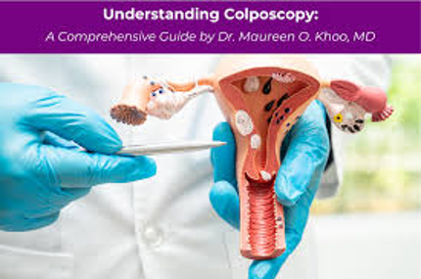
Colposcopy
Definition
Colposcopy is a diagnostic procedure in which a healthcare provider examines the cervix, vagina, and vulva using a special magnifying instrument called a colposcope. The procedure helps identify abnormal cells, infections, precancerous changes, and early signs of cancer.

Slide 3
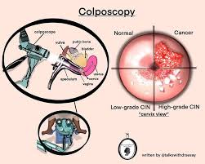
Purpose of Colposcopy
A colposcopy is usually recommended when:
A Pap smear (Pap test) shows abnormal results.
A person tests positive for Human Papillomavirus (HPV).
There is unexplained vaginal bleeding.
The cervix appears abnormal during a pelvic examination.
There are visible lesions, genital warts, or suspicious growths.
Follow-up evaluation of previously detected cervical abnormalities is needed.

Slide 4
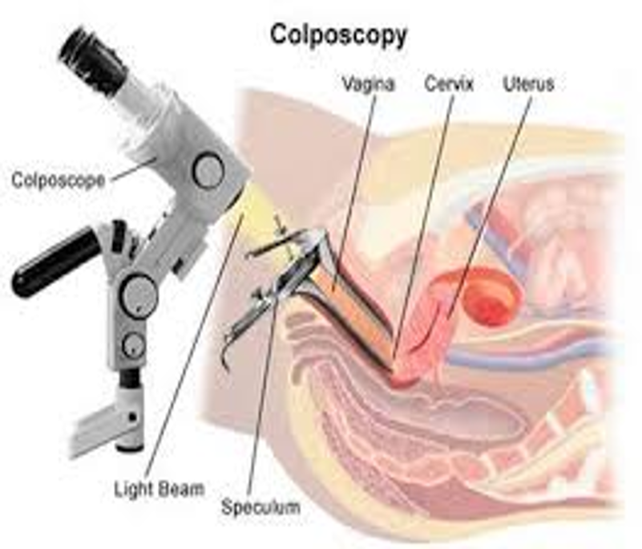
Equipment Used
Colposcope (a binocular microscope with a light source)
Vaginal speculum
Acetic acid solution (3–5% vinegar solution)
Lugol's iodine solution (optional)
Cotton swabs
Biopsy forceps (if tissue sampling is required)

Slide 5
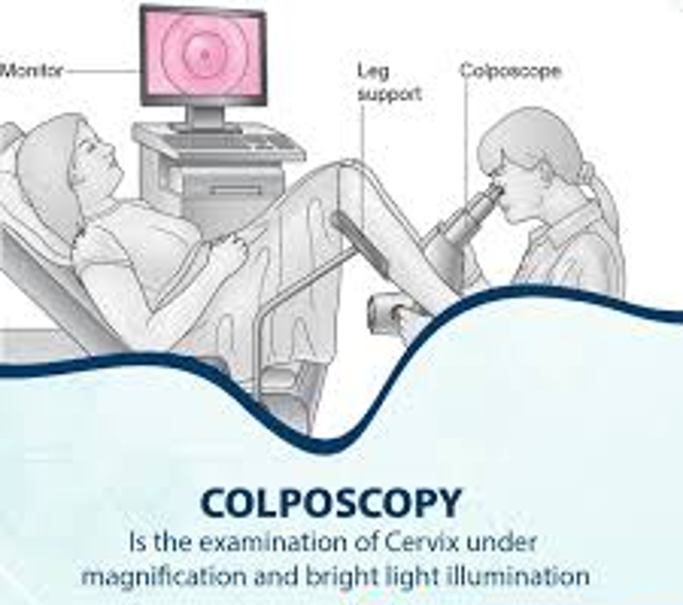
Procedure of Colposcopy
Before the Procedure
Schedule when not menstruating.
Avoid intercourse, tampons, douching, and vaginal medications for 24–48 hours.
Empty the bladder before the examination.
During the Procedure
Patient lies in the lithotomy position.
A speculum is inserted to view the cervix.
The colposcope is positioned outside the vagina.
Acetic acid is applied to highlight abnormal areas.
The cervix is examined under magnification.
Lugol's iodine may be applied if needed.
A biopsy is taken if any abnormal area is detected.
Duration: Approximately 10–20 minutes.

Slide 6
Findings During Colposcopy
The examiner may identify:
Normal cervical tissue
Cervical inflammation (cervicitis)
HPV-related changes
Cervical Intraepithelial Neoplasia (CIN)
CIN 1 (Mild Dysplasia): Abnormal cells in the lower one-third of the cervix; often resolves naturally.
CIN 2 (Moderate Dysplasia): Abnormal cells extend up to two-thirds of the cervical lining; may require treatment.
CIN 3 (Severe Dysplasia): Abnormal cells involve most or all of the cervical lining; considered a precancerous condition and usually requires treatment.
Cervical cancer
Vaginal or vulvar lesions

Slide 7
Advantages
Risks and Complications
Simple outpatient procedure.
No anaesthesia usually required.
Early detection of precancerous cervical lesions.
Helps guide biopsy from abnormal areas.
Improves diagnosis after abnormal Pap smear results.
Colposcopy itself is very safe.
Rare complications include:
Mild discomfort or cramping
Light vaginal bleedingInfection (rare)
Bleeding after biopsy

Slide 8
Indications
Contraindications
Abnormal Pap smear
Positive HPV test
Suspicious cervical lesions
Postcoital bleeding
Follow-up of cervical dysplasia
Severe acute pelvic infection
Heavy menstrual bleeding (relative contraindication)

Slide 9
Hysterosalpingography (HSG)

Slide 10
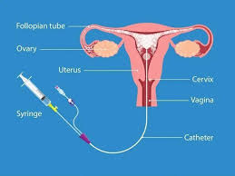
Definition
Hysterosalpingography (HSG) is a specialized X-ray procedure used to examine the uterus and fallopian tubes. A contrast dye is injected through the cervix, and X-ray images are taken to detect blockages, abnormalities, or causes of infertility.

Slide 11
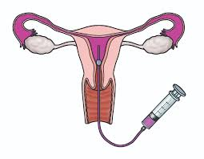
Purpose
Evaluate female infertility.
Check whether the fallopian tubes are open or blocked.
Detect abnormalities of the uterus.
Assess recurrent miscarriages.
Evaluate the success of tubal surgery.

Slide 12
Procedure
Before the Procedure
Scheduled after menstruation and before ovulation.
Pregnancy must be excluded.
Patient may be advised to take a pain reliever.
During the Procedure
Patient lies on the X-ray table.
A speculum is inserted into the vagina.
A catheter is placed through the cervix.
Contrast dye is injected into the uterus.
X-ray images are taken as the dye flows through the uterus and fallopian tubes.
The procedure takes about 15–30 minutes.
After the Procedure
Mild cramping and spotting may occur.
Normal activities can usually be resumed the same day.
https://www.youtube.com/watch?v=FZijxxeV5_Q

Slide 13
Findings
Advantages
Simple and minimally invasive.
Provides valuable information about fertility.
Can sometimes improve fertility by flushing minor tubal blockages.
Normal uterine cavity.
Open (patent) fallopian tubes.
Blocked fallopian tubes.
Uterine fibroids or polyps.
Congenital uterine abnormalities.
Intrauterine adhesions (Asherman's syndrome).
Risks
Mild pain or cramping.
Infection (rare).
Allergic reaction to contrast dye (rare).
Vaginal spotting.

Slide 14
Scrotal Ultrasonography (Scrotal USG)

Slide 15
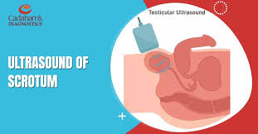
Definition
Scrotal Ultrasonography
(Scrotal USG) is a non-invasive imaging procedure that uses high-frequency sound waves to produce images of the testes, epididymis, spermatic cord, and surrounding scrotal structures. It is the primary diagnostic tool for evaluating scrotal abnormalities.

Slide 16
Purpose
Indications
Assess scrotal pain or swelling.
Detect testicular abnormalities.
Evaluate infertility-related conditions.
Diagnose trauma or injury to the scrotum.
Differentiate between benign and malignant masses.
Scrotal pain
Swelling or lumps in the scrotum
Suspected varicocele or hydrocele
Testicular torsion
Infections (epididymitis, orchitis)
Infertility evaluation
Testicular tumors
Scrotal trauma

Slide 17
Procedure
Before the Procedure
No special preparation is required.
The patient lies comfortably on the examination table.
During the Procedure
The patient lies in a supine position.
A gel is applied to the scrotal area.
An ultrasound transducer is moved gently over the scrotum.
Images of both testes and surrounding structures are obtained.
Color Doppler ultrasound may be used to assess blood flow.
The procedure usually takes 15–30 minutes.
After the Procedure
The gel is wiped off.
The patient can resume normal activities immediately.

Slide 18
Common Findings
Varicocele
Enlargement of veins within the scrotum, often associated with infertility.
Hydrocele
Collection of fluid around the testicle causing painless swelling.
Testicular Torsion
Twisting of the spermatic cord leading to reduced blood supply; a medical emergency.
Epididymitis/Orchitis
Inflammation or infection of the epididymis or testis.
Testicular Tumor
Abnormal mass within the testis that may require further evaluation.
Scrotal Trauma
Detection of injury, hematoma, or rupture of the testis.

Slide 19
Advantages
Risks
Non-invasive and painless.
No radiation exposure.
Quick and accurate.
Provides real-time imaging.
Excellent for evaluating blood flow with Doppler imaging.
No known significant risks.
Safe for all age groups.

Slide 20


